Slide 1
EnhanceMicroAlgae Project
WP1. PROJECT COORDINATION
Consortium meeting, La Rochelle (FR), 21/10/2022
Gonzalo Ojea
ANFACO-CECOPESCA

Slide 2
EnhanceMicroAlgae extension
Start date: 28/01/2022 End date: 30/06/2023
WP1. PROJECT COORDINATION. Leader: ANFACO-CECOPESCA
Official notification of the extension project
We need to submit all information (activities and expenses) from the previous project, so the JS can proceed with contractualisation of the extension project and new PAF in SIGI.
Progress Reports
According to the Programme Manual, “Lead Partners have to submit 2 progress reports in each 12 months period to the MA through the JS”. This includes the following steps: 1. Progress Report submission from each partner, based on the activities it is participating, as defined in the project work plan. The paid expenses with the related evidences corresponding to the activities are introduced on the SIGI, 2. FLC/NA control of expenditures, 3. Progress Report consolidation from the Lead Partner and submission, including the related ERDF reimbursement claim.
At least one of those two reports must include financial data and payment claim. In cases where project partners do not report any expenditure after 2 semesters, they will receive a warning from the programme, issued to the Lead Partner.
All activities and expenses of the “previous” project must be submitted before reporting on the “extension” project.

Slide 3
EnhanceMicroAlgae extension
Start date: 28/01/2022 End date: 30/06/2023
WP1. PROJECT COORDINATION. Leader: ANFACO-CECOPESCA
Situation of Progress Reports of the previous project
 | Project Progress Reports PPR | 5
1 | ANFACO | Validated
2 | Swansea University (SU) | Validated
3 | University of Manchester (UM) | Validated
4 | Fac. Ciencias Univ. Porto (FCUP) | Validated
5 | Universidade da Coruña (UDC) | Validated
6 | Université de La Rochelle (ULR) | Agree FLC deduction
7 | Teagasc Food Research Centre | Validated
8 | Glecex | Not Created
9 | INL | Agree NA deduction

Slide 4
EnhanceMicroAlgae extension
Start date: 28/01/2022 End date: 30/06/2023
WP1. PROJECT COORDINATION. Leader: ANFACO-CECOPESCA
Financial situation of the previous project
 | Budget | Expenditure on SIGI (20/10/2022)
1 ANFACO-CECOPESCA | 420.200,00 | 417.914,99
2 Swansea University | 315.707,40 | 303.480,83
3 University of Manchester | 320.800,00 | 314.947,65
4 FCUP | 201.554,00 | 201.500,05
5 Universidade da Coruña | 250.550,00 | 225.135,69
6 Université de La Rochelle | 280.800,00 | 238.540,39
7 Teagasc | 267.900,00 | 252.846,08
8 GLECEX | 137.050,00 | 130.653,51
9 INL | 261.735,00 | 216.916,72
TOTAL | 2.456.296,40 | 2.301.935,91

Slide 5
EnhanceMicroAlgae extension
Start date: 28/01/2022 End date: 30/06/2023
WP1. PROJECT COORDINATION. Leader: ANFACO-CECOPESCA
Budget of the extended project
 | 2022 | 2023 | Total | 93,0055%
1.ANFACO | 100.000,00 | 90.000,00 | 190.000,00 | 176.710,45
2.SU | 69.522,25 | 34.761,13 | 104.283,38 | 96.989,28
3.UM | 112.537,00 | 56.269,00 | 168.806,00 | 156.998,86
4.FCUP | 46.000,00 | 40.500,00 | 86.500,00 | 80.449,76
5.UDC |  |  |  | 0,00
6.ULR | 19.635,00 | 5.115,00 | 24.750,00 | 23.018,86
7.Teagasc | 76.500,00 | 39.460,00 | 115.960,00 | 107.849,18
8.Glecex | 55.000,00 | 25.000,00 | 80.000,00 | 74.404,40
9.INL | 52.480,95 | 26.104,65 | 78.585,60 | 73.088,93
11.A4F | 122.246,25 | 52.391,25 | 174.637,50 | 162.422,48
12.Buggypower | 33.335,00 | 16.665,00 | 50.000,00 | 46.502,75
14.Aqualgae | 35.000,00 | 15.000,00 | 50.000,00 | 46.502,75
TOTAL | 669.775,50 | 375.161,38 | 1.044.936,88 | 1.044.937,70

Slide 6
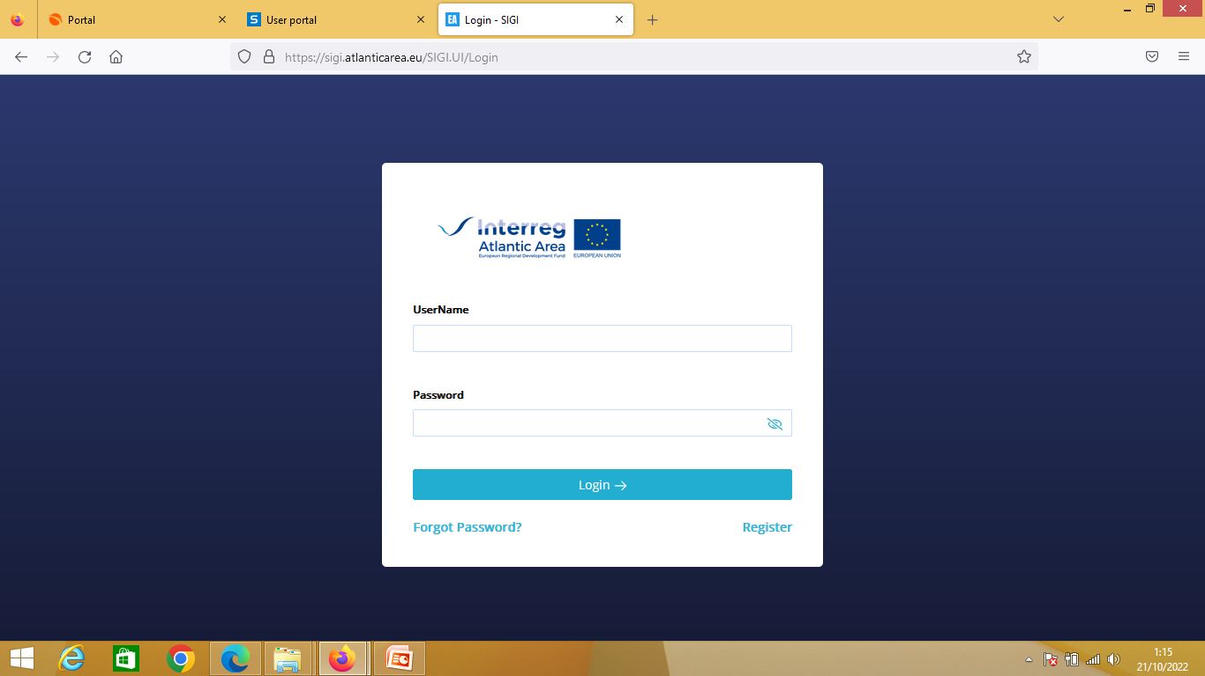
EnhanceMicroAlgae extension
Start date: 28/01/2022 End date: 30/06/2023
WP1. PROJECT COORDINATION. Leader: ANFACO-CECOPESCA
Technical and financial management (Progress Reports)
For the new full partners:
please check my email sent on 19/04/22
https://sigi.atlanticarea.eu/SIGI.UI/Login

Slide 7
EnhanceMicroAlgae
Atlantic Area Programme 2021-2027
First Call for Projects 2022
The call opened on 14th of October 2022. Deadline: 17th of February 2023
https://www.atlanticarea.eu/page/78
Regions included: France (Bretagne ; Normandie, Nouvelle-Aquitaine, Pays de la Loire); Ireland; Portugal (including Açores and Madeira); Spain (País Vasco; Navarra; La Rioja; Cantabria; Asturias; Galicia; Andalucía; Canarias).
Priorities:
- Priority 1: Blue innovation and competitiveness - Priority 2: Blue/Green environment - Priority 3: Blue sustainable and social tourism & culture
Total budget preferentially between EUR 1 and 3.5 million. Co-financing: up to 75%.
Indicative duration: up to 36 months. Should involve 4 to 12 full partners, at least one per country of the cooperation area.
Lead Partner: public bodies, universities, education and research organisations, private institutions (not-for-profit) or international organisations.

